Slide 1
Hosting a Static Website on Azure Storage
Hosting a static website on Azure Storage is a straightforward, cost-effective solution for lightweight web applications like personal blogs, portfolios, or documentation. This guide walks you through the process of creating and deploying a static website using Azure's Storage Account service.
BY:
K.CHANDRA SHEKAR
K.AKHIL REDDY
G.REVANTH REDDY
K.SANJANA

Slide 2
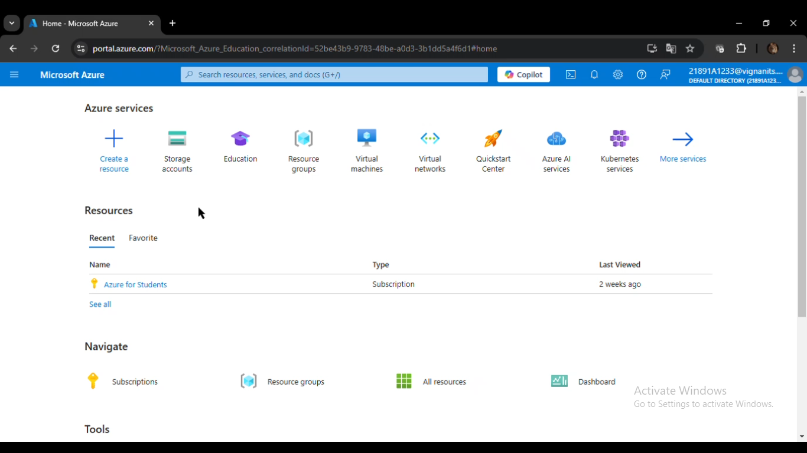
IMPLEMENTATION :

Slide 3
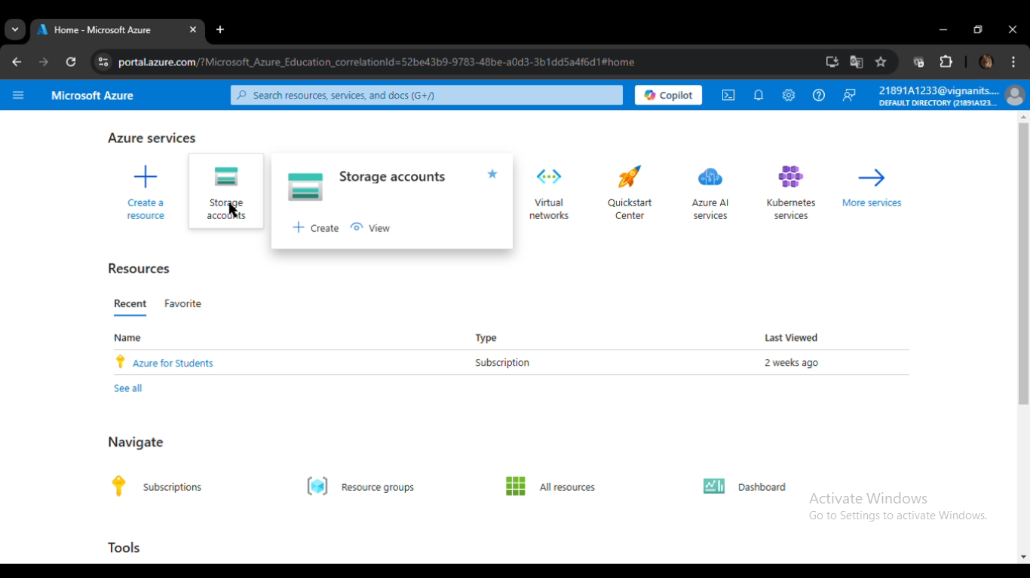

Slide 4
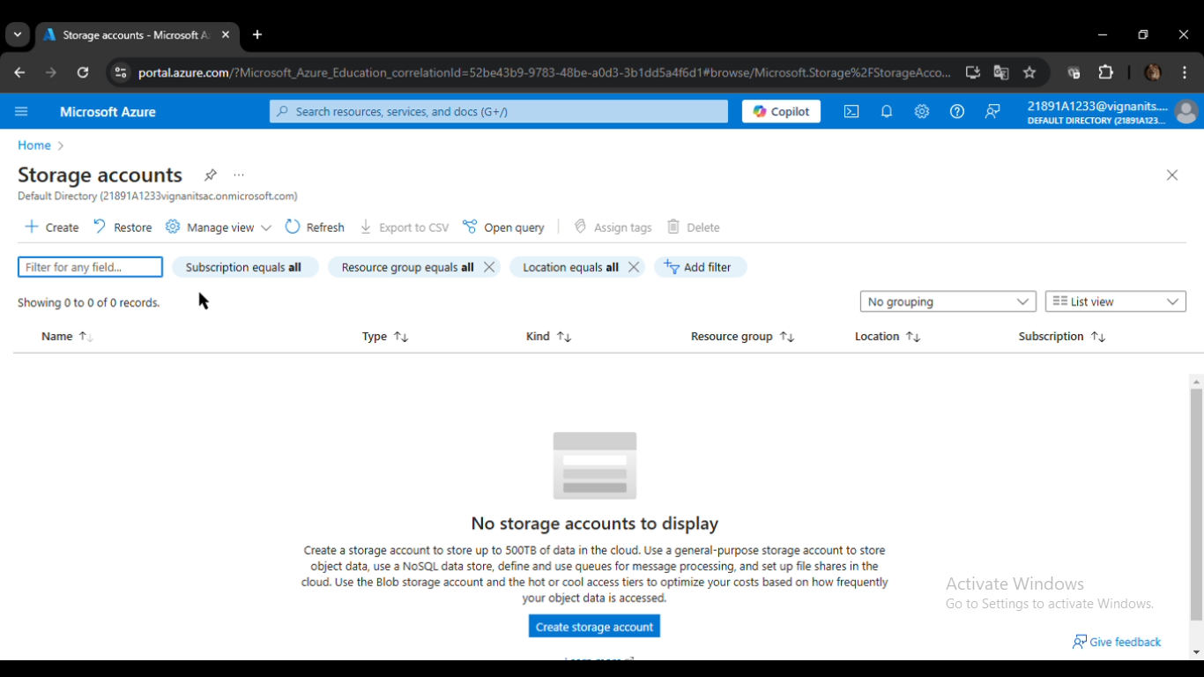

Slide 5
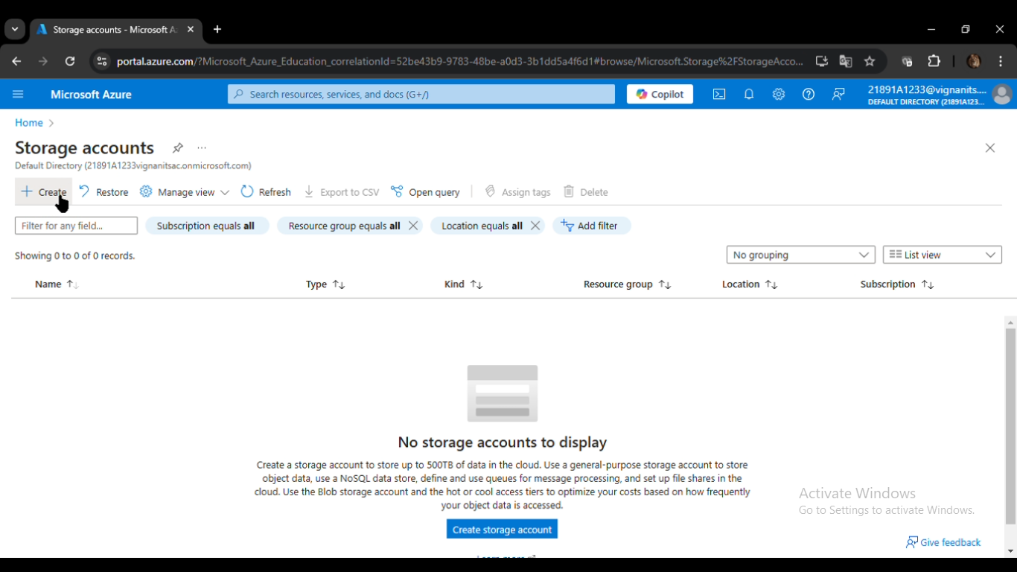

Slide 6
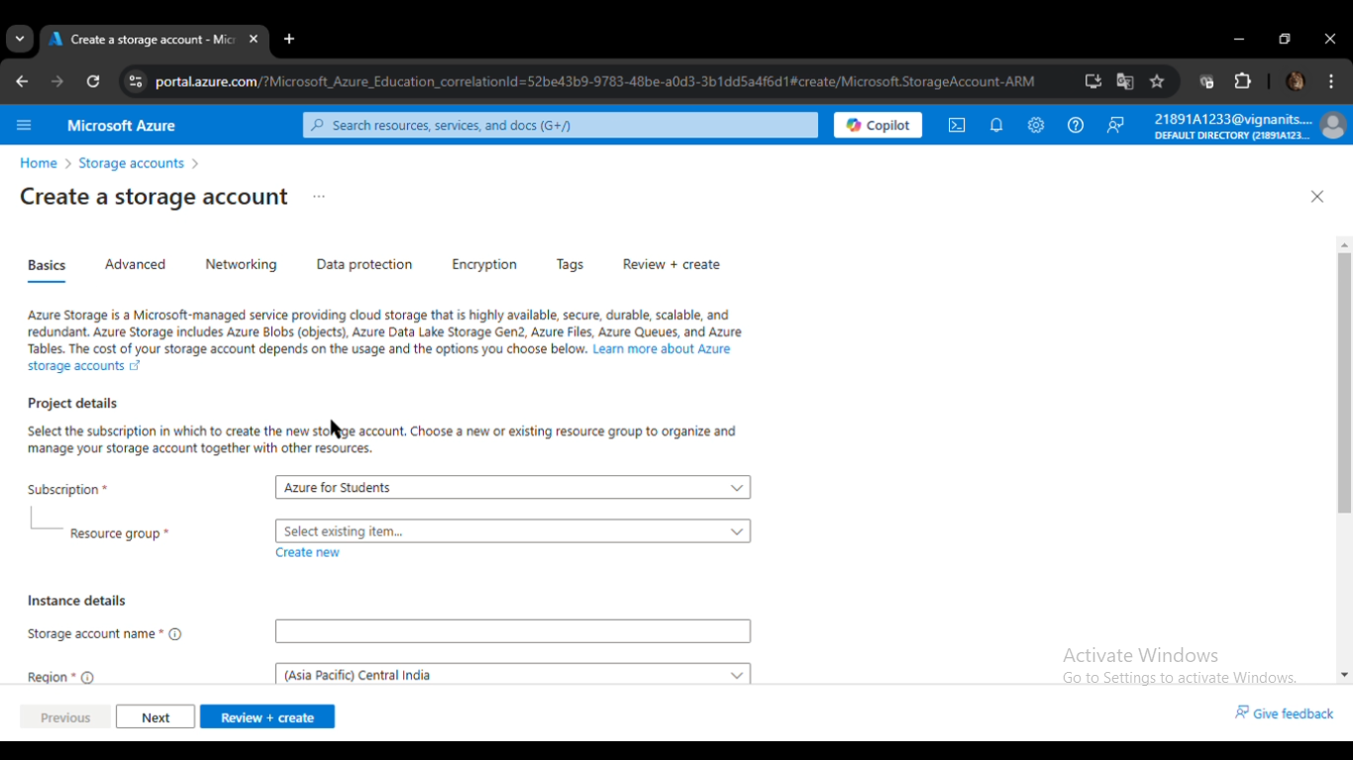

Slide 7
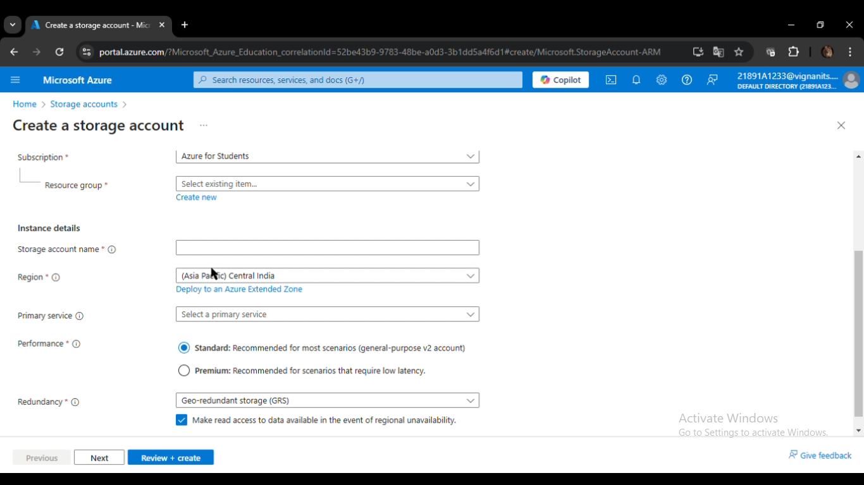

Slide 8
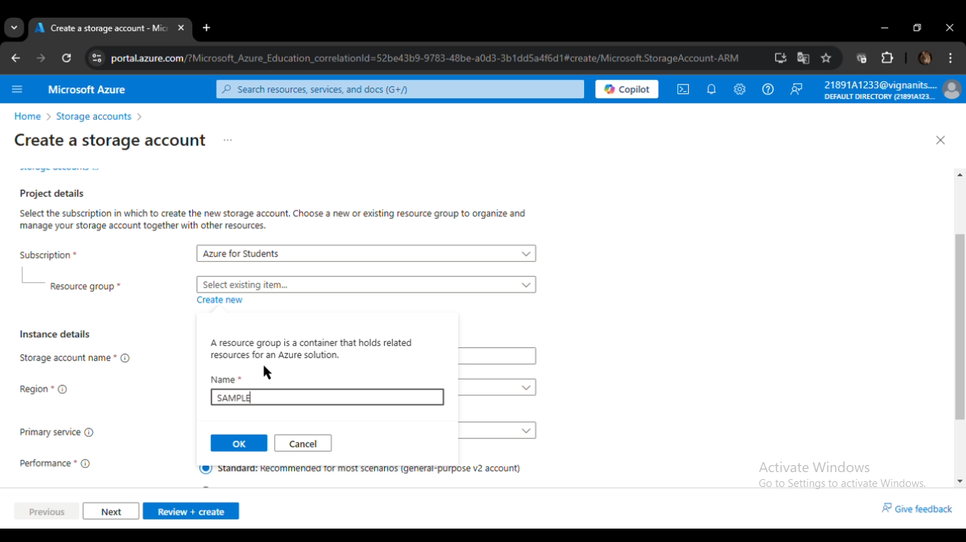

Slide 9
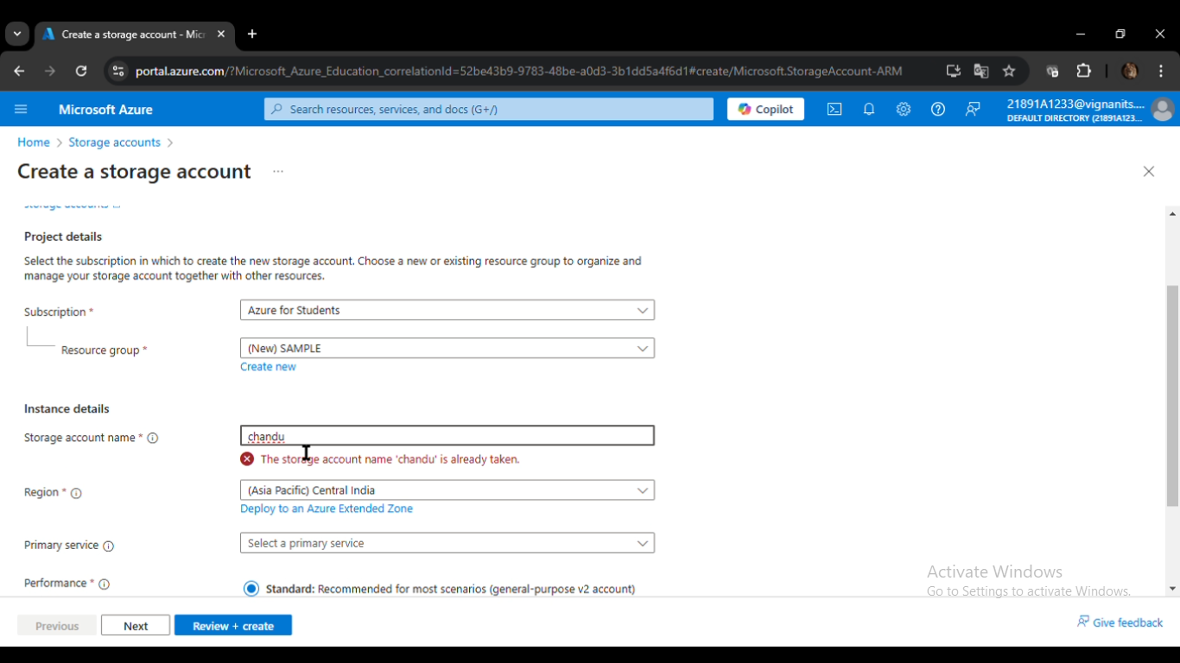

Slide 10
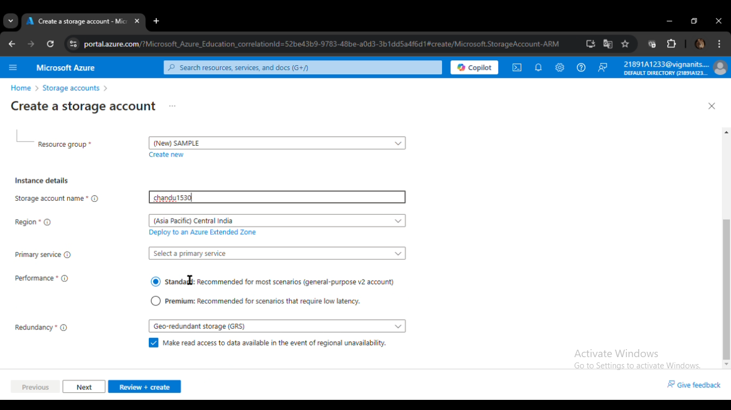

Slide 11
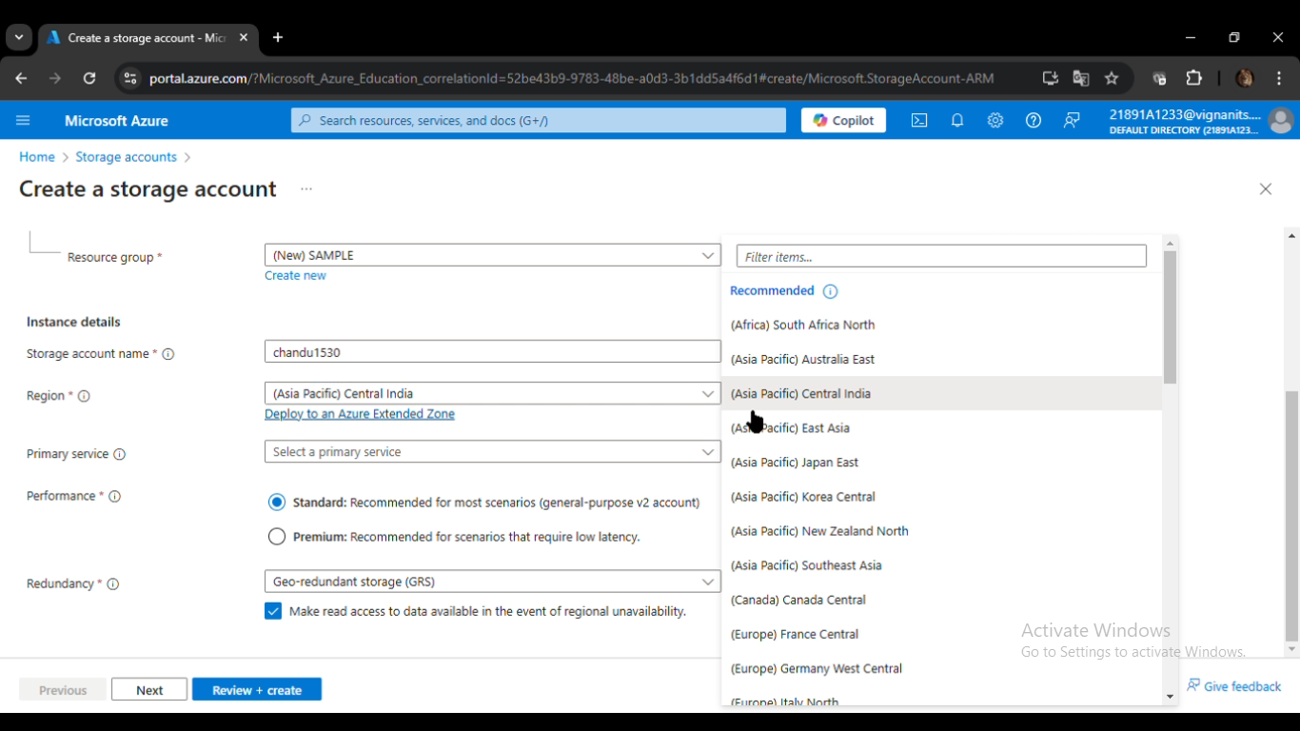

Slide 12
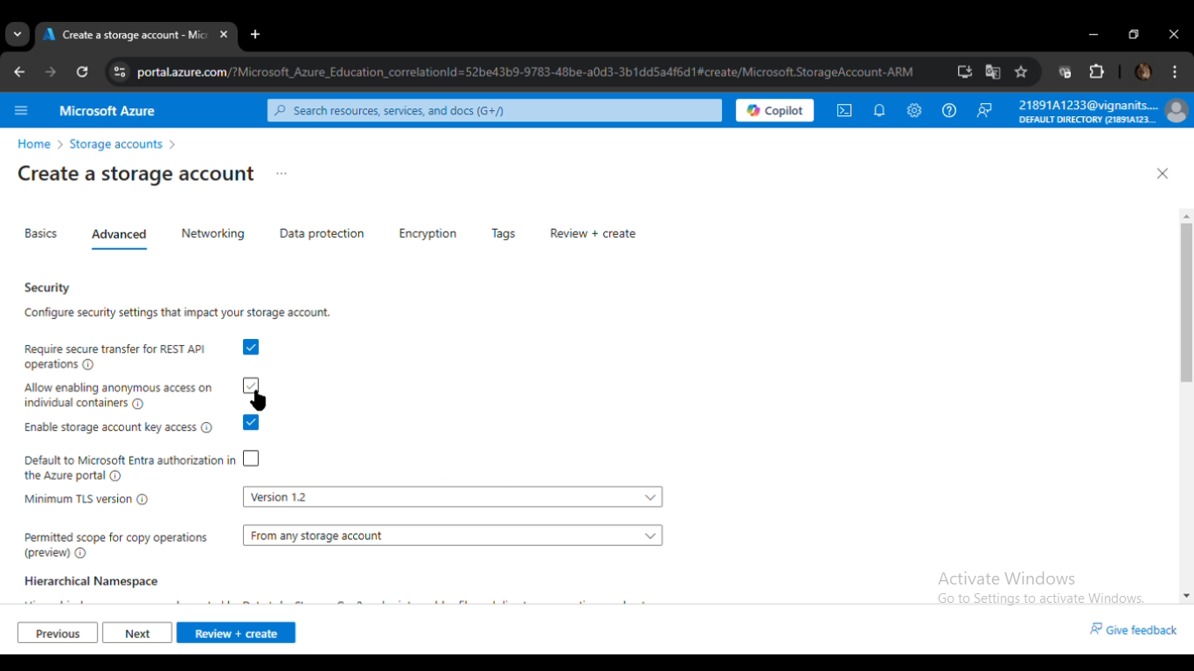

Slide 13
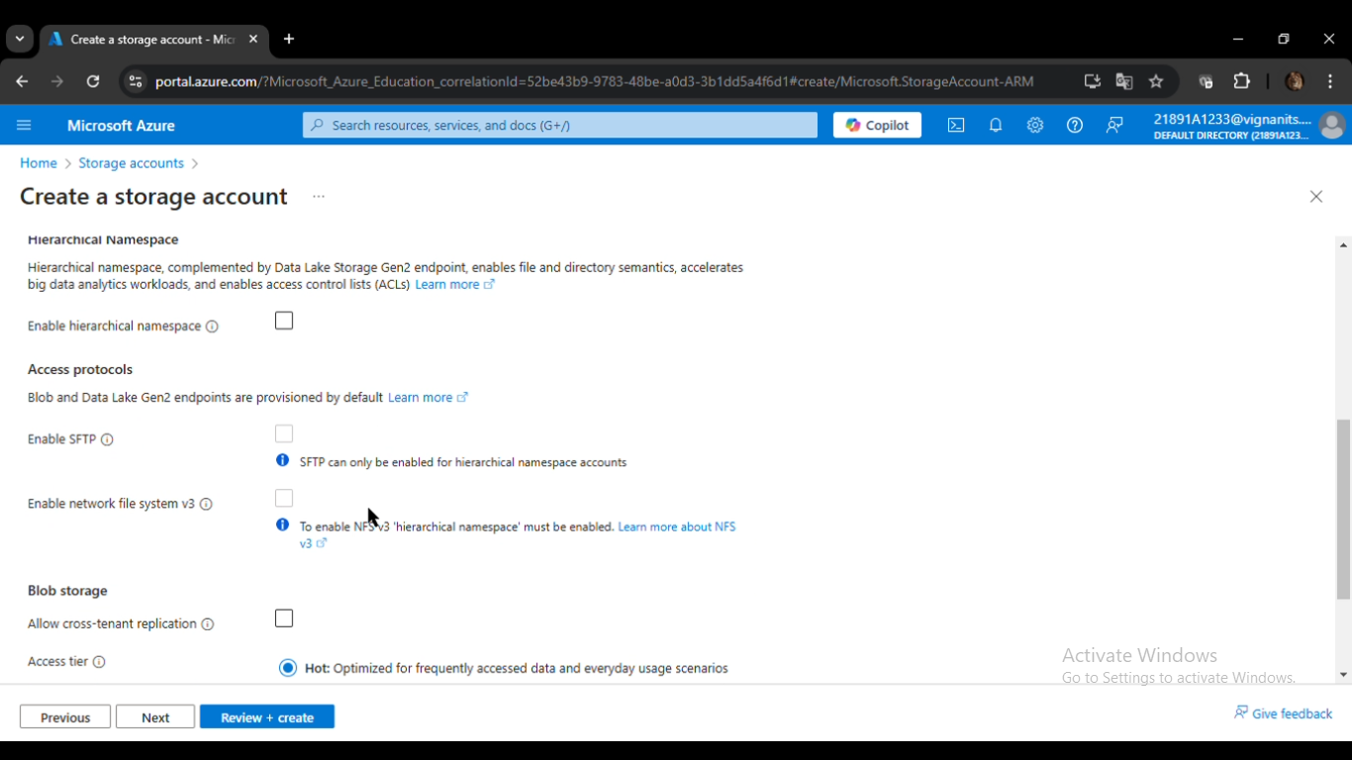

Slide 14
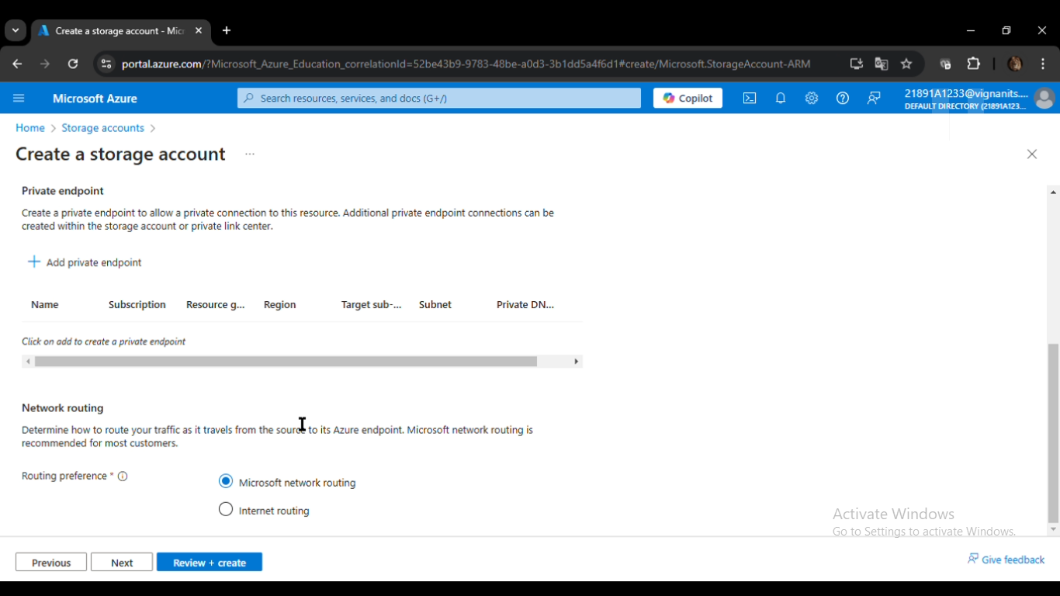

Slide 15
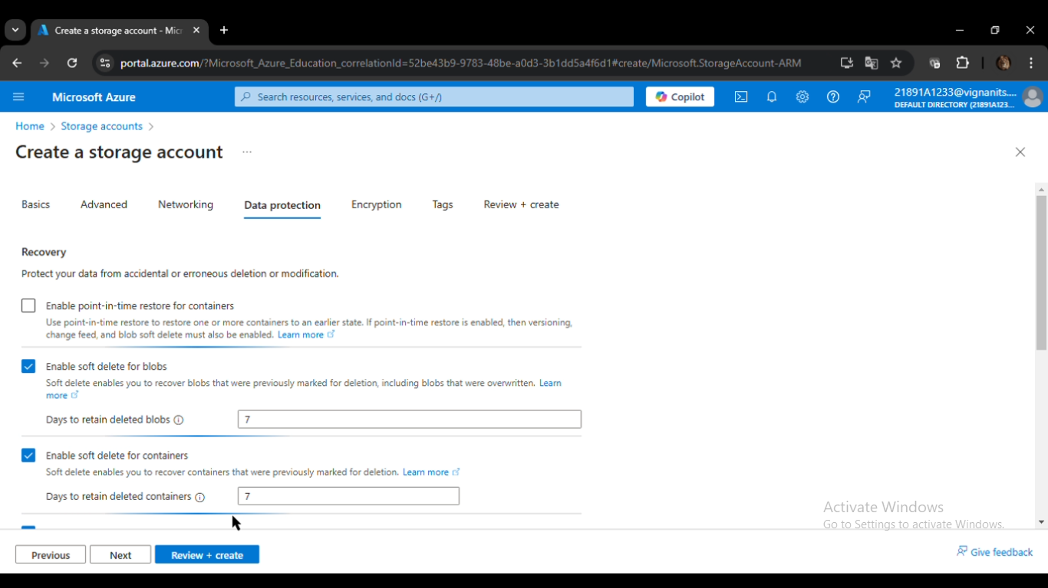

Slide 16
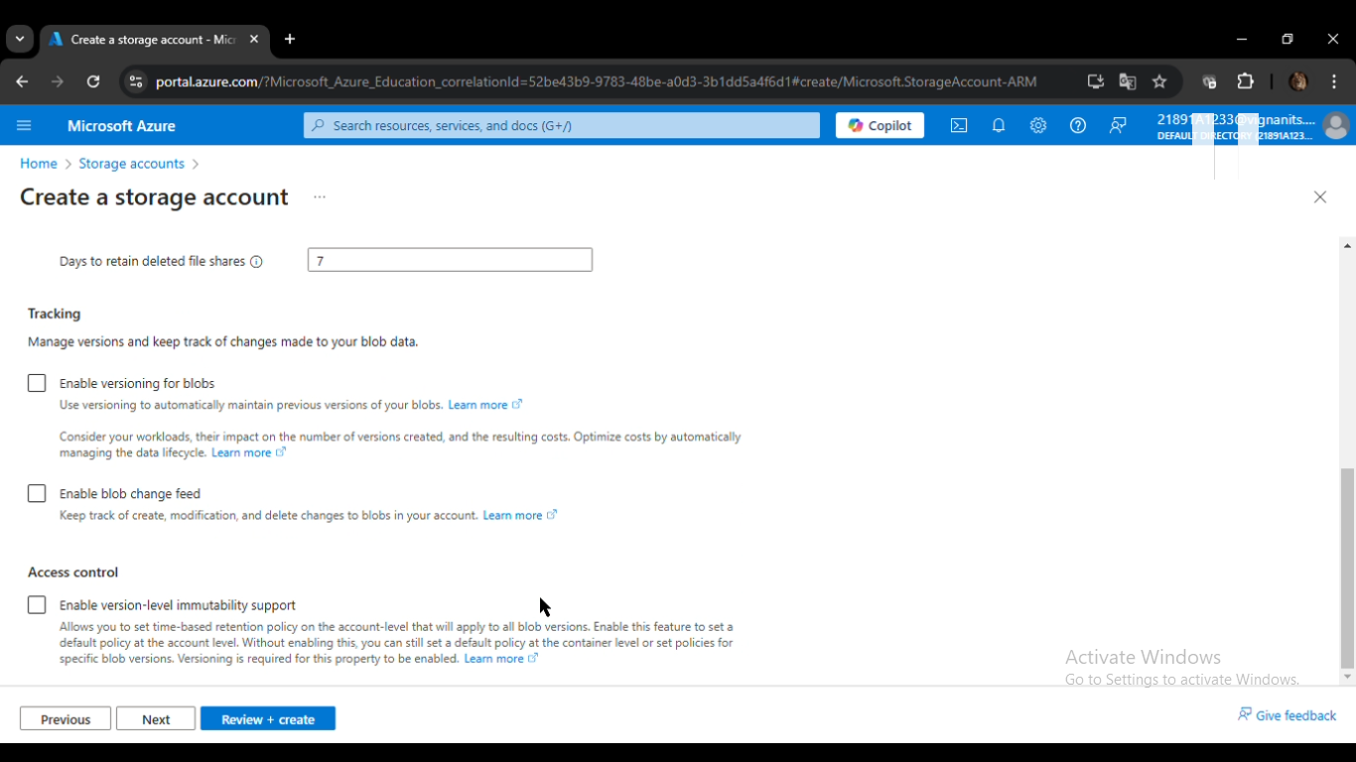

Slide 17
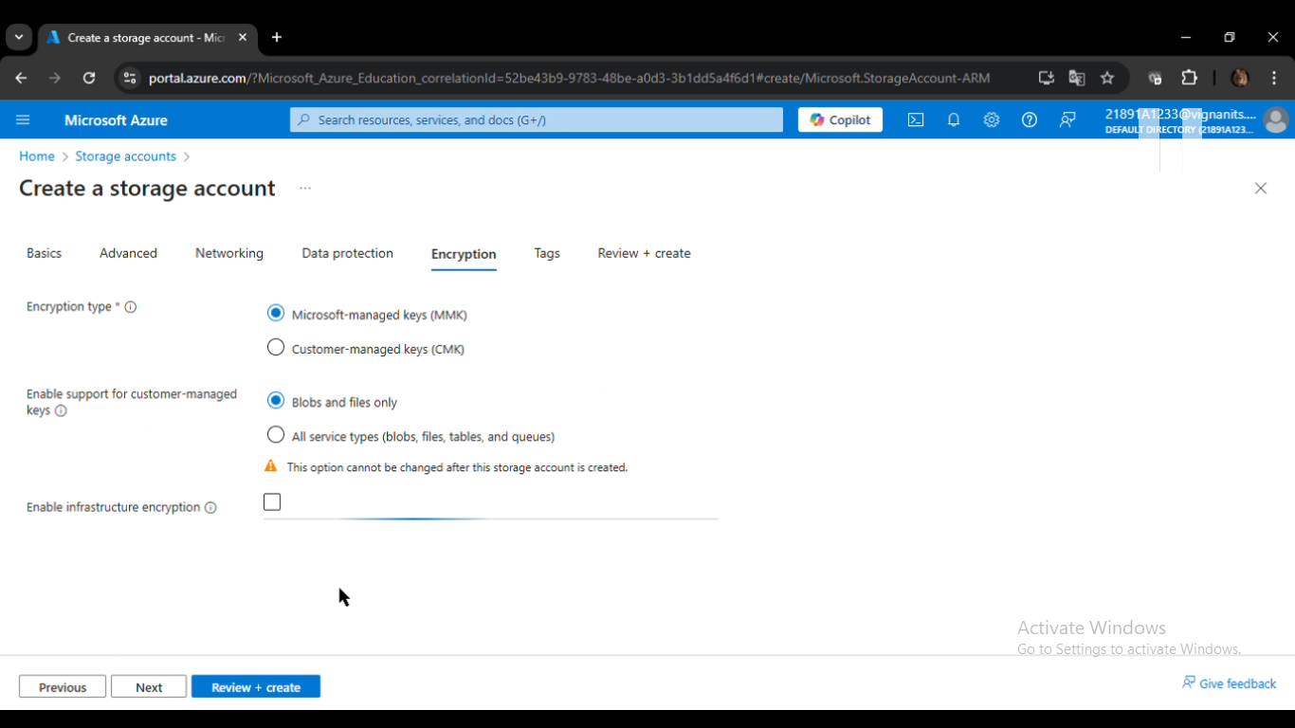

Slide 18
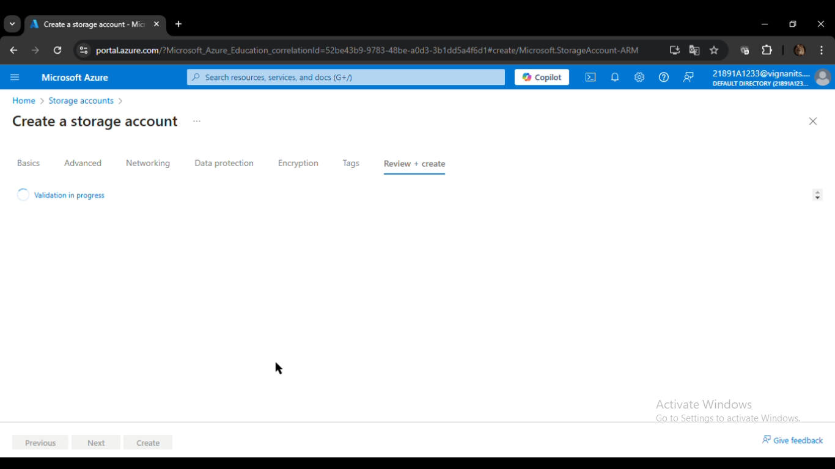

Slide 19
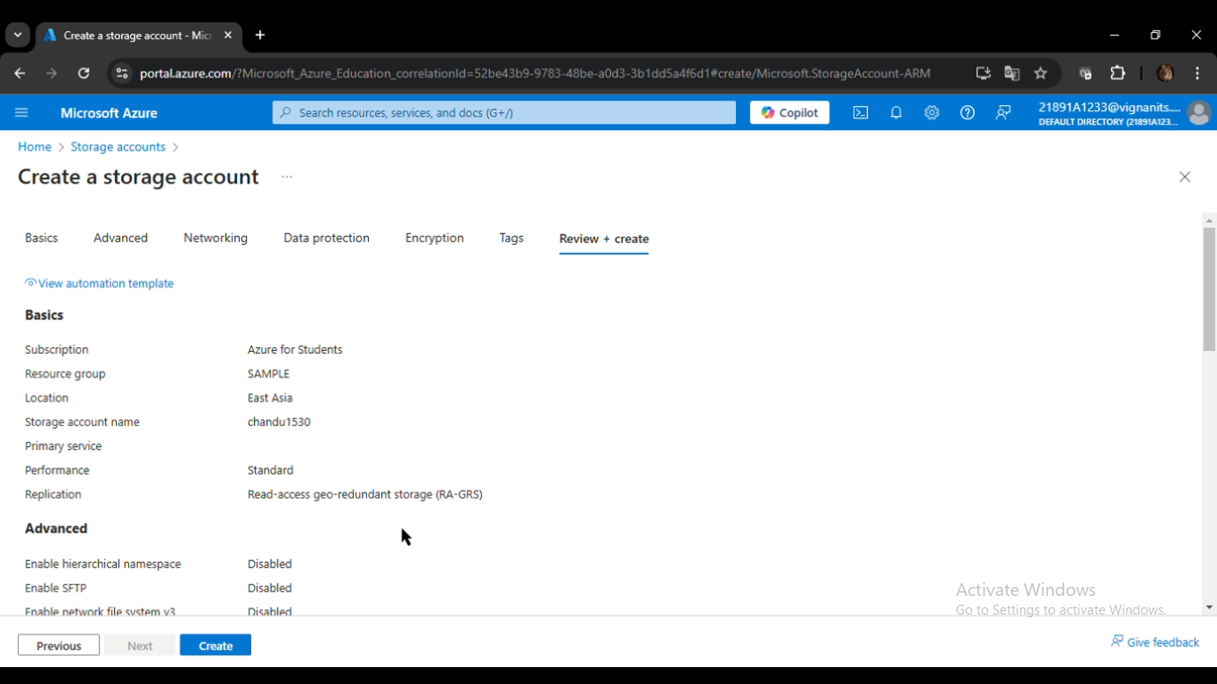

Slide 20
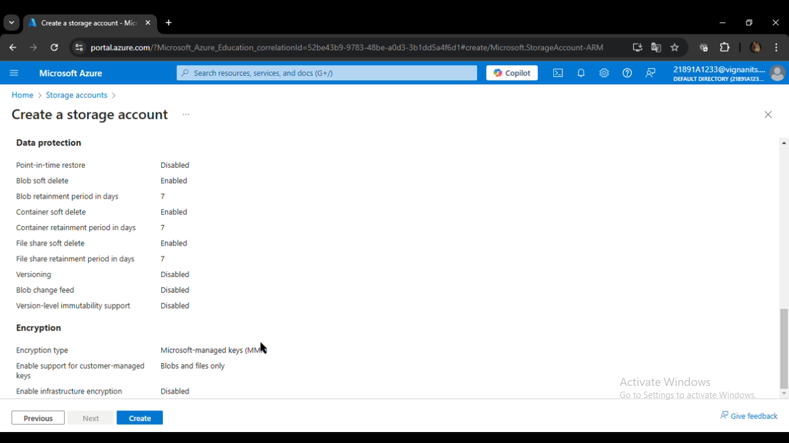

Slide 21
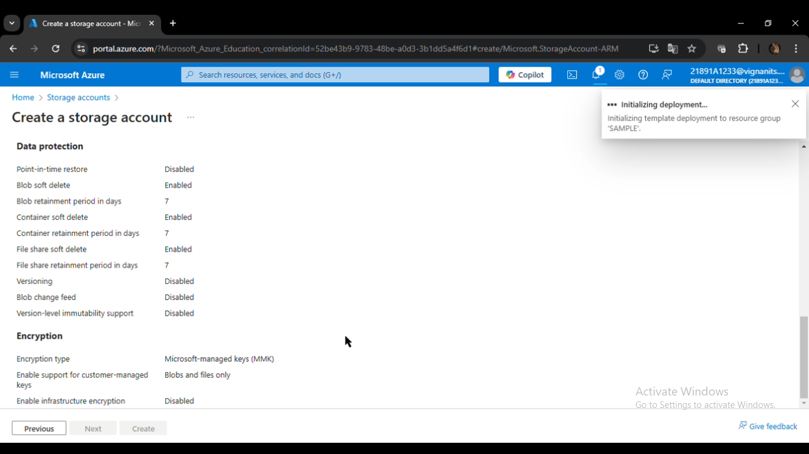

Slide 22


Slide 24
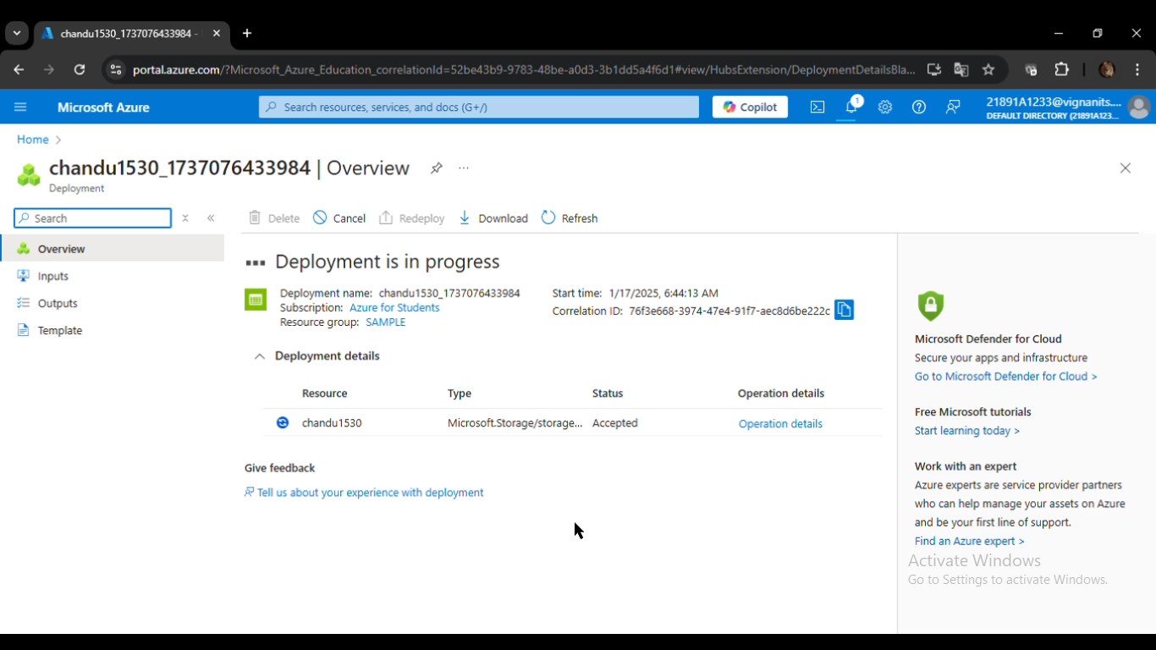

Slide 25
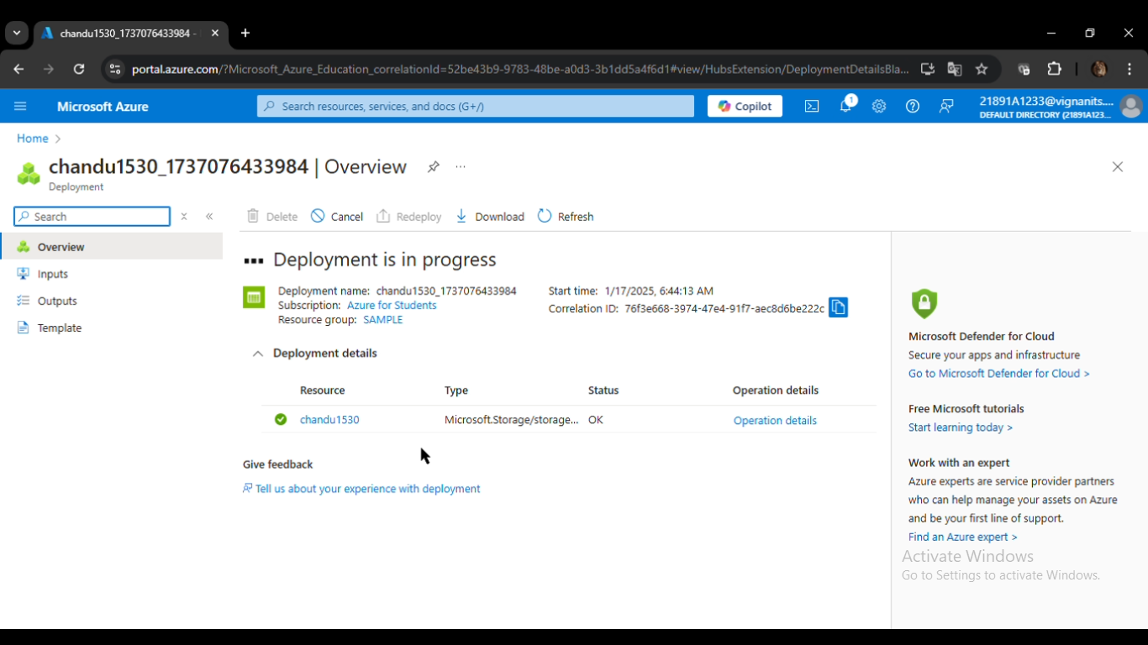

Slide 26
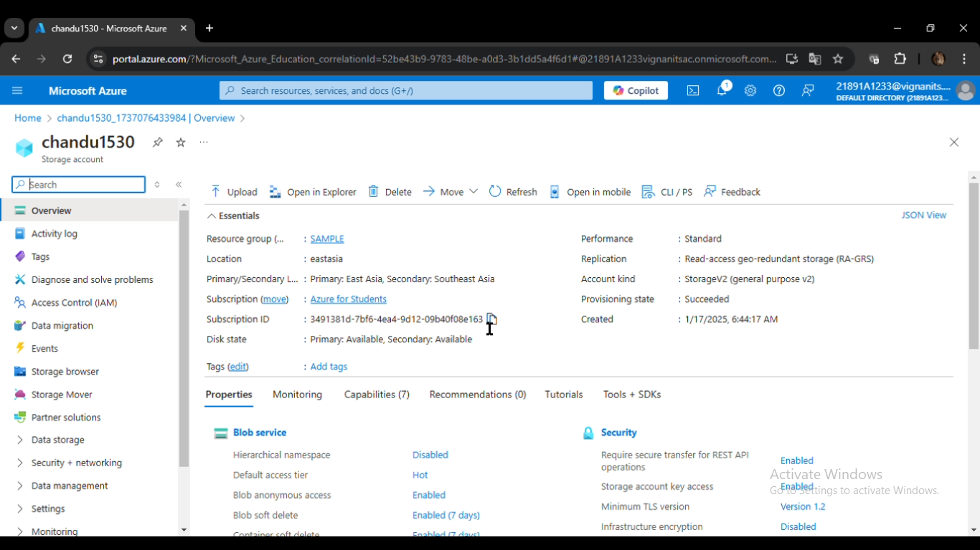

Slide 27
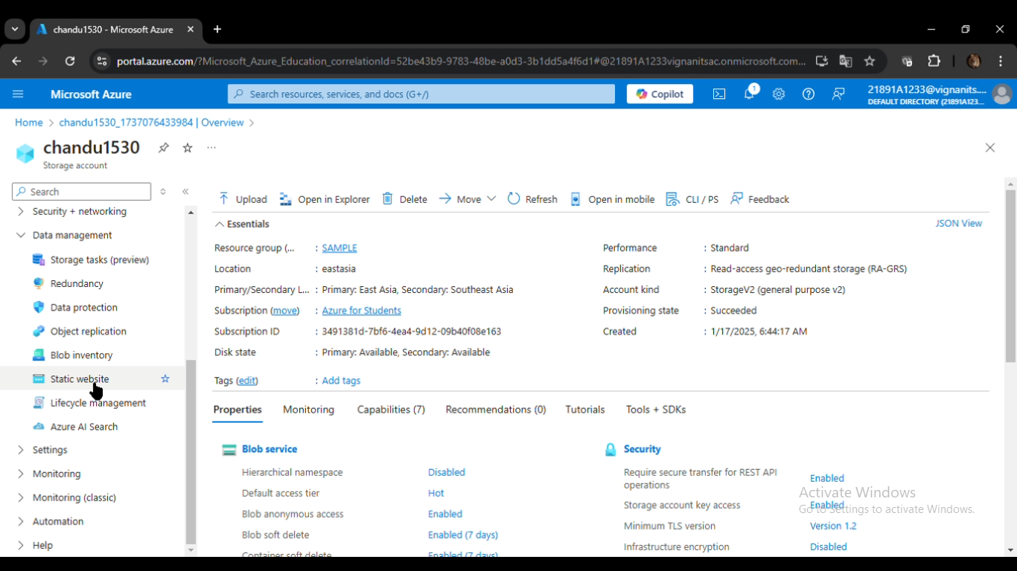

Slide 28
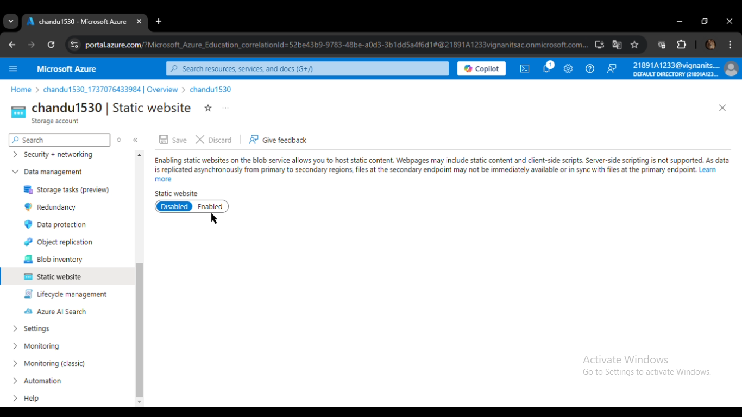

Slide 29
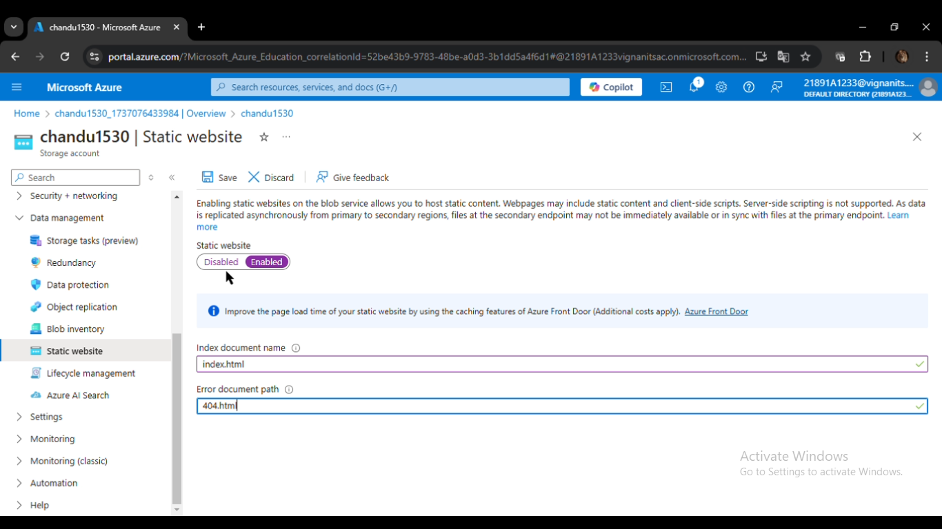

Slide 30
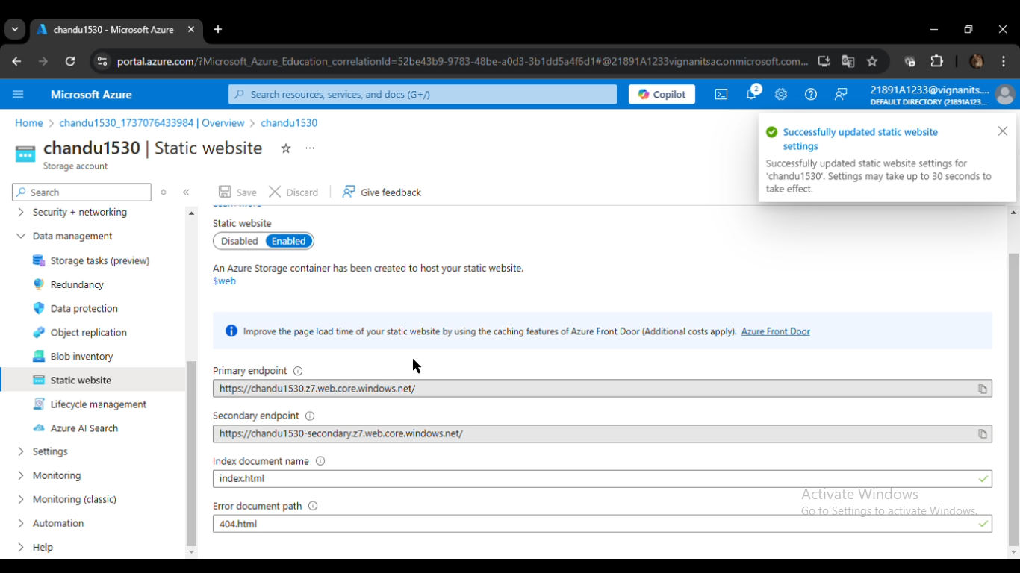

Slide 31
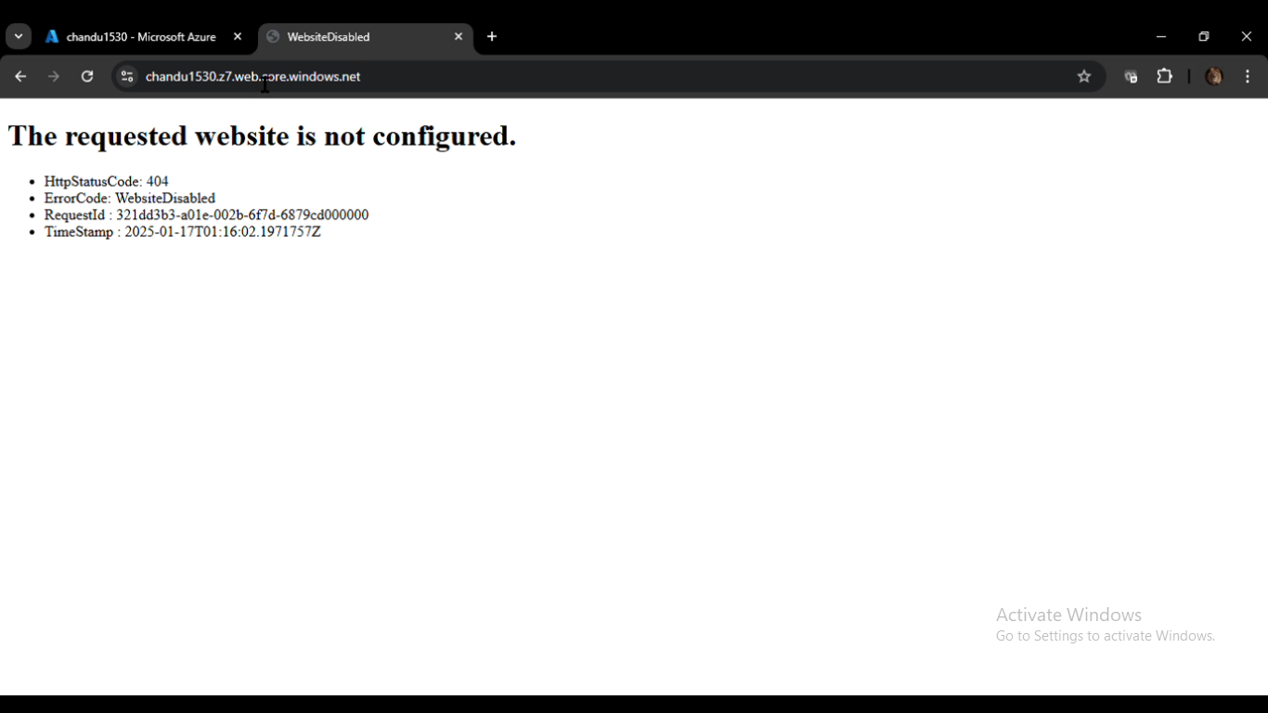

Slide 32
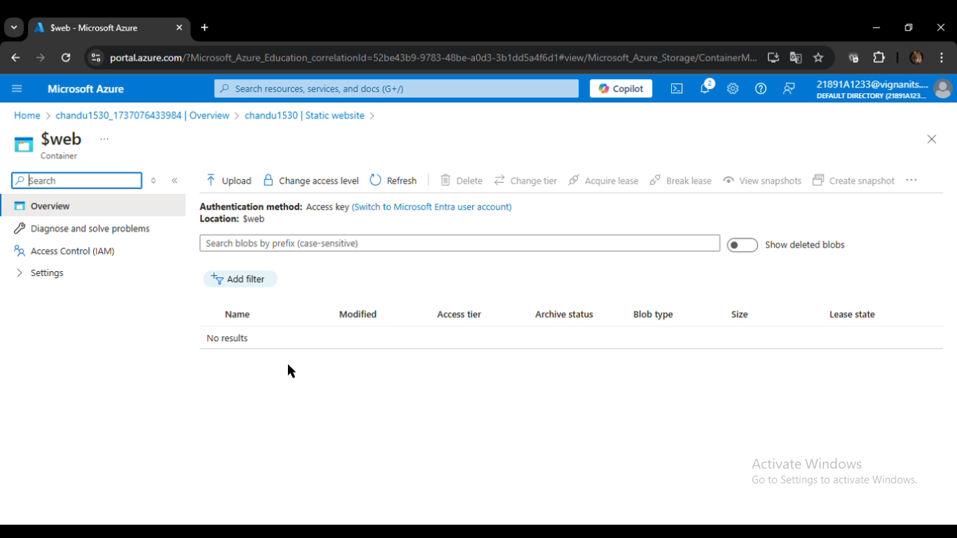

Slide 33
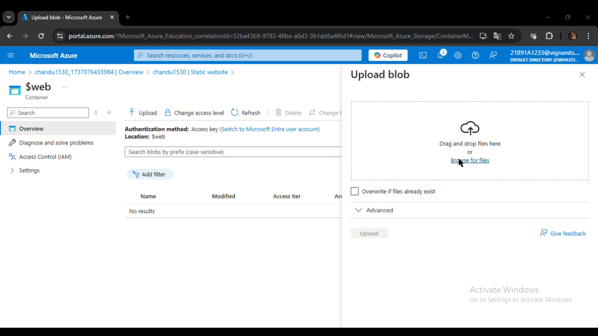

Slide 34
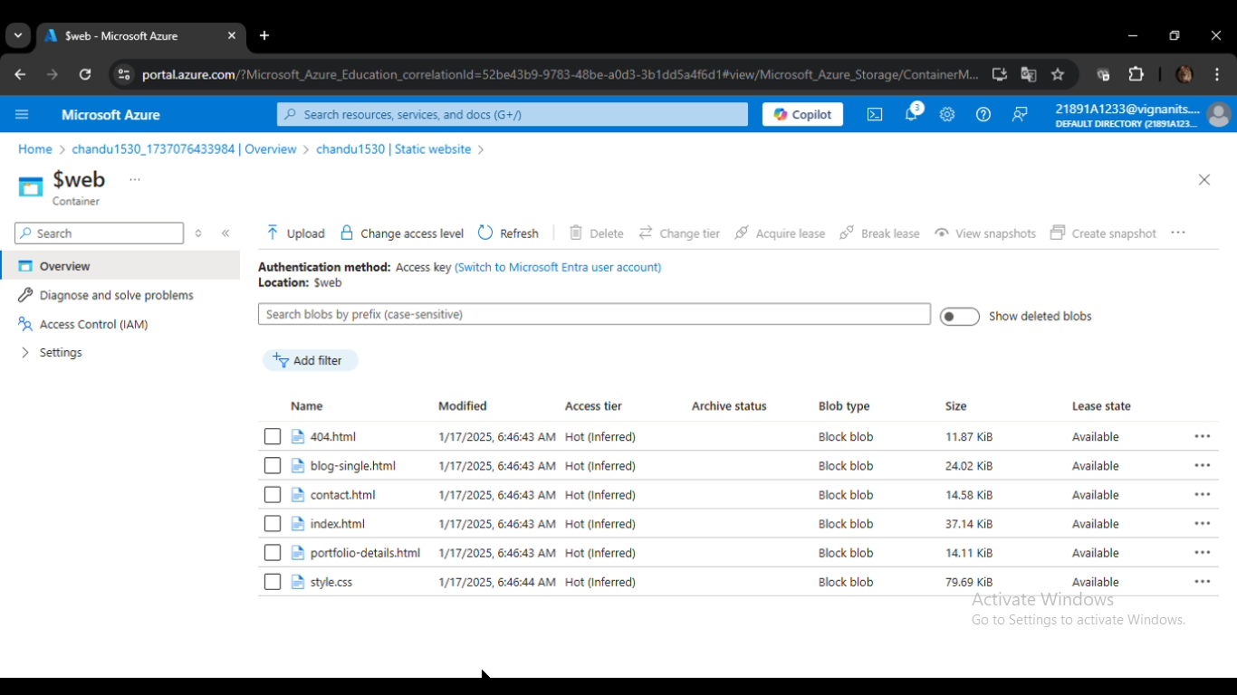

Slide 35
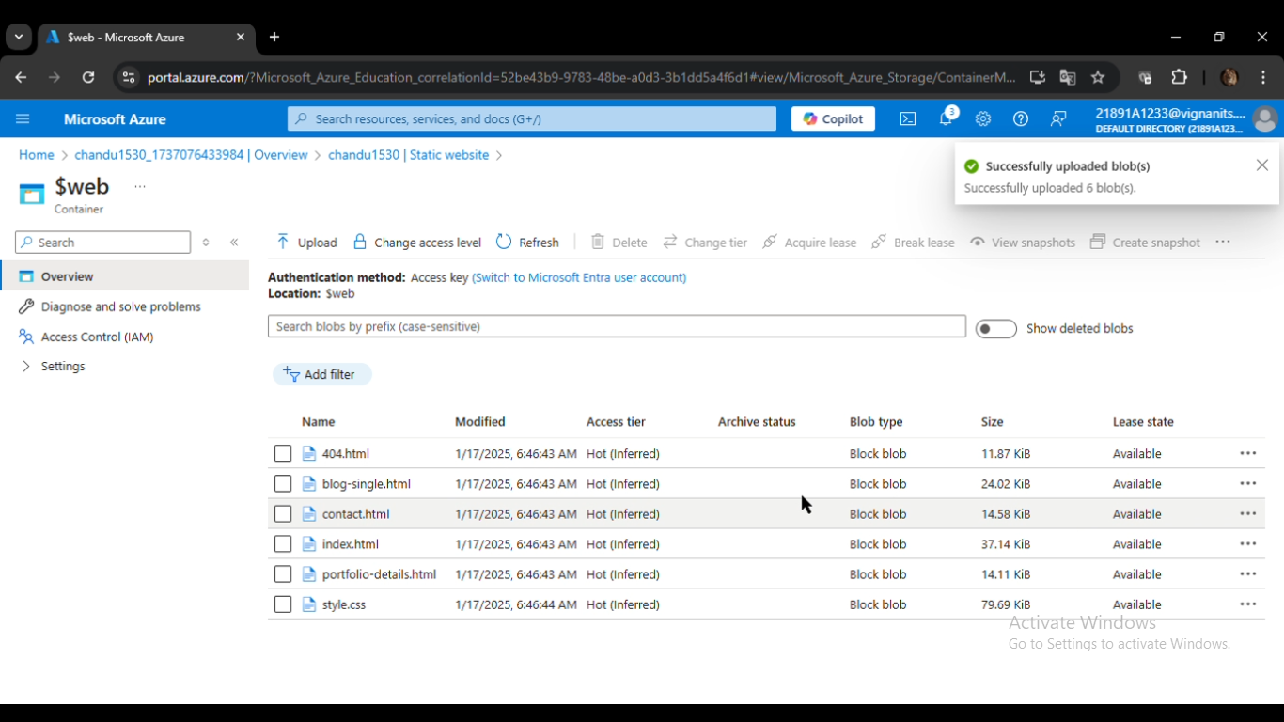

Slide 36
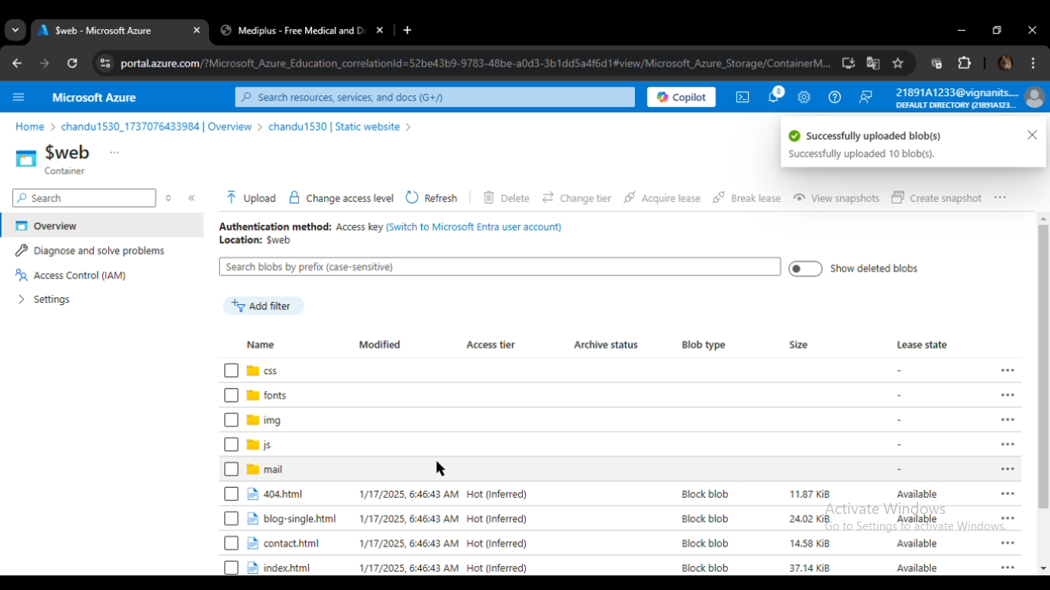

Slide 37


Slide 38
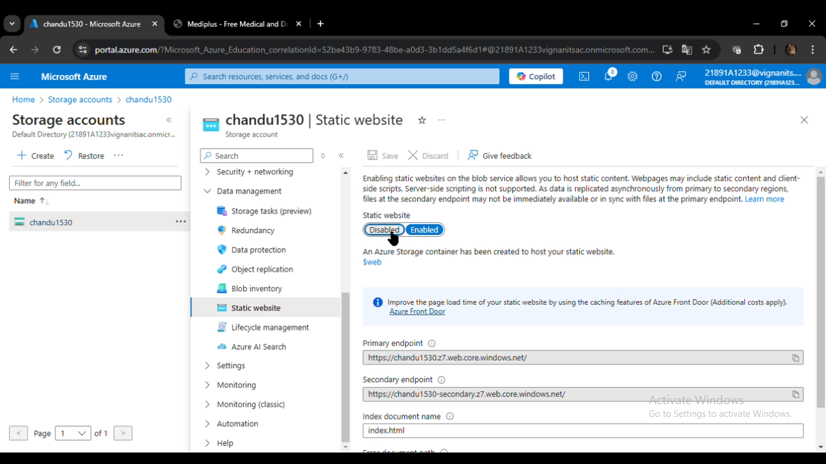

Slide 39
ADVANTAGES :
Cost-Effectiveness: Hosting static websites on Azure Storage is significantly cheaper compared to using traditional web hosting solutions.
High Availability: Azure ensures data redundancy and availability, making your website resilient to failures.
Scalability: The service can handle traffic spikes without additional configuration.
Simplicity: No need to manage web servers or complex configurations.
Global Reach: Azure's globally distributed data centers ensure low-latency access for users worldwide.

Slide 40
THANK YOU

